Slide 1
Setup React Project
Install Node.js
Make sure you have Node.js installed on your system. You can download it from: https://nodejs.org/
Verify installation by running:
node -v
npm -v
Create a React App
You can set up a new React project using Vite:
setup a react project along with boilerplate code:
npm create vite@latest my-app -- --template react
Change current working directory to the directory created in previous step:
cd my-app
Install the npm packages listed in package.json:
npm install

Slide 2
Setup React Project
We now need to install another important package react-router-dom. This package will be used for routing/navigation on frontend.
npm install react-router-dom
Run React App in development mode by running this command: npm run dev
All commands are listed under “scripts” in package.json

Slide 3
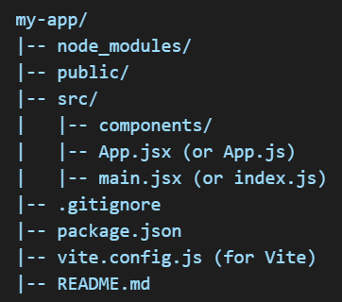
Project Structure in React
A typical project structure in react looks like this:

Slide 4
Project Structure in React
The components folder will contain react component files as jsx.
JSX stands for JavaScript XML. It is a syntax extension for JavaScript that allows embedding HTML-like code directly within JavaScript.
Browsers don’t understand JSX, so it must be transpiled into regular JavaScript before execution. This is done using a React compiler, i.e. Babel, Esbuild, etc.
Each react component is usually placed in a separate jsx file.
For reusable react components, we can place them in a folder called common inside the components folder.

Slide 5
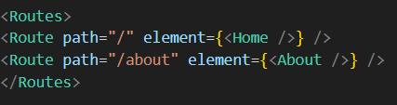
Routing/Navigation in React
React routing is the process of navigating between different pages or views in a single-page application (SPA) without requiring a full page reload. In React, routing is typically handled by the react-router-dom package.
Routes & Route
Defines the mapping between URLs and components.
We typically place the mapping between URLs and react components in the App component in App.jsx.
The <App/> (imported from App.jsx) component in main.jsx is also wrapped in BrowserRouter component provided by react-router-dom.

Slide 6
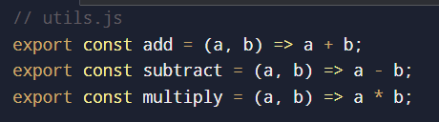
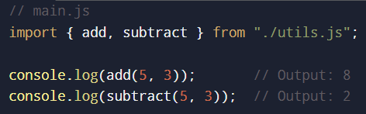
JavaScript Module Exports: Named Export vs. Default Export
In JavaScript, modules allow you to organize and reuse code efficiently. The two primary ways to export and import code between files are:
Named Export – Export multiple variables/functions/classes from a module.
Default Export – Export a single main variable/function/classes from a module.
Named Export
A named export allows you to export multiple items from a module using specific names. When importing, you must use the exact exported names.
Example: Exporting Multiple Named Items
Now import named exports from utils.js using:

Slide 7
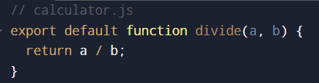
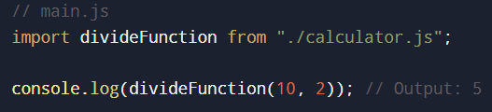
JavaScript Module Exports: Named Export vs. Default Export
Default Export
A default export is used to export a single primary item from a module. When importing, you can name it whatever you like.
Example: Exporting Multiple Named Items
To import a default item:

Slide 8
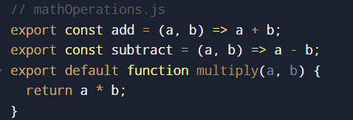
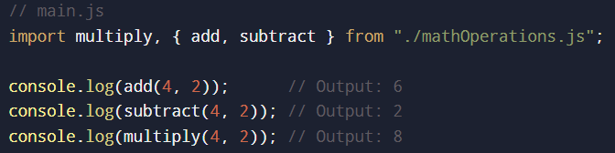
JavaScript Module Exports: Named Export vs. Default Export
Combine Named and Default Exports

Slide 9
Package versioning in package.json
https://docs.npmjs.com/about-semantic-versioning

